Slide 1
Read across the ahern
*Photos and examples
are from past RAA Days
(2014 – 2017)

Slide 2
Guest readers from across our community are invited to come in to read some wonderful stories with students, talk about their own reading habits, and share in our special day.

Slide 4
Students are encouraged to wear Seuss-inspired
clothes and colors (red, white, black)…

Slide 5
…and are welcome to participate in an OPTIONAL tri-fold reading fair project.

Slide 6
Julia’s project on Mr. Popper’s Penguins by Richard and Florence Atwater earned her FIRST PLACE in the 2014 competition. Her efforts even earned her a new book and a gift card!!!
Notice how she included the:
TITLE
AUTHOR’S NAME
ILLUSTRATOR’S NAME
PUBLICATION (COPYRIGHT) DATE
on the middle of her board.

Slide 7
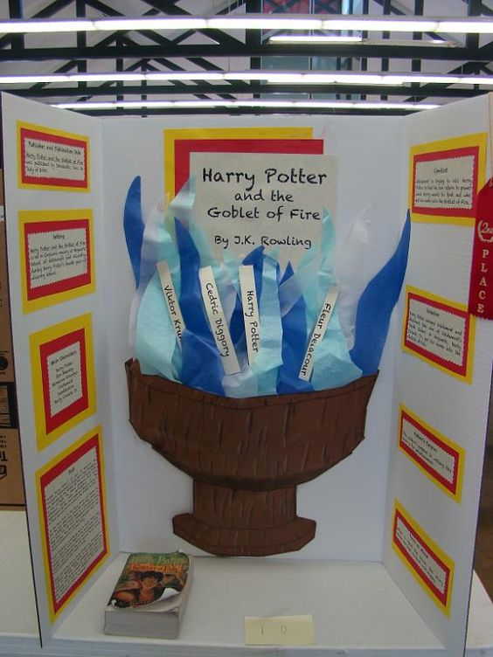
Sometimes readers choose to pick more challenging chapter books to use for their projects like this student’s neat, easy to read Harry Potter and the Goblet of Fire trifold.

Slide 8
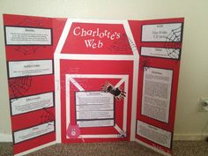
Kelsey did her project on Charlotte’s Web by E.B. White. She made it unique by adding 3D elements to her project, while another student made their trifold into a barn.

Slide 9
Michael and Sarah showed their creative sides by using different mediums to create backgrounds for their projects.

Slide 10
Some students paint or draw their backgrounds, add googly eyes, and even glue puffy foam flowers onto their boards.
Let your imagination run wild as long as nothing is sticking out of the top, bottom, or sides of the board.

Slide 11
As you watch, be sure to notice how the projects can be fiction or nonfiction. Depending on which you choose, there are certain requirements that must be included. The winning projects are always neat, complete, show effort and creativity, and are obviously created by students (not adults).

