Slide 1
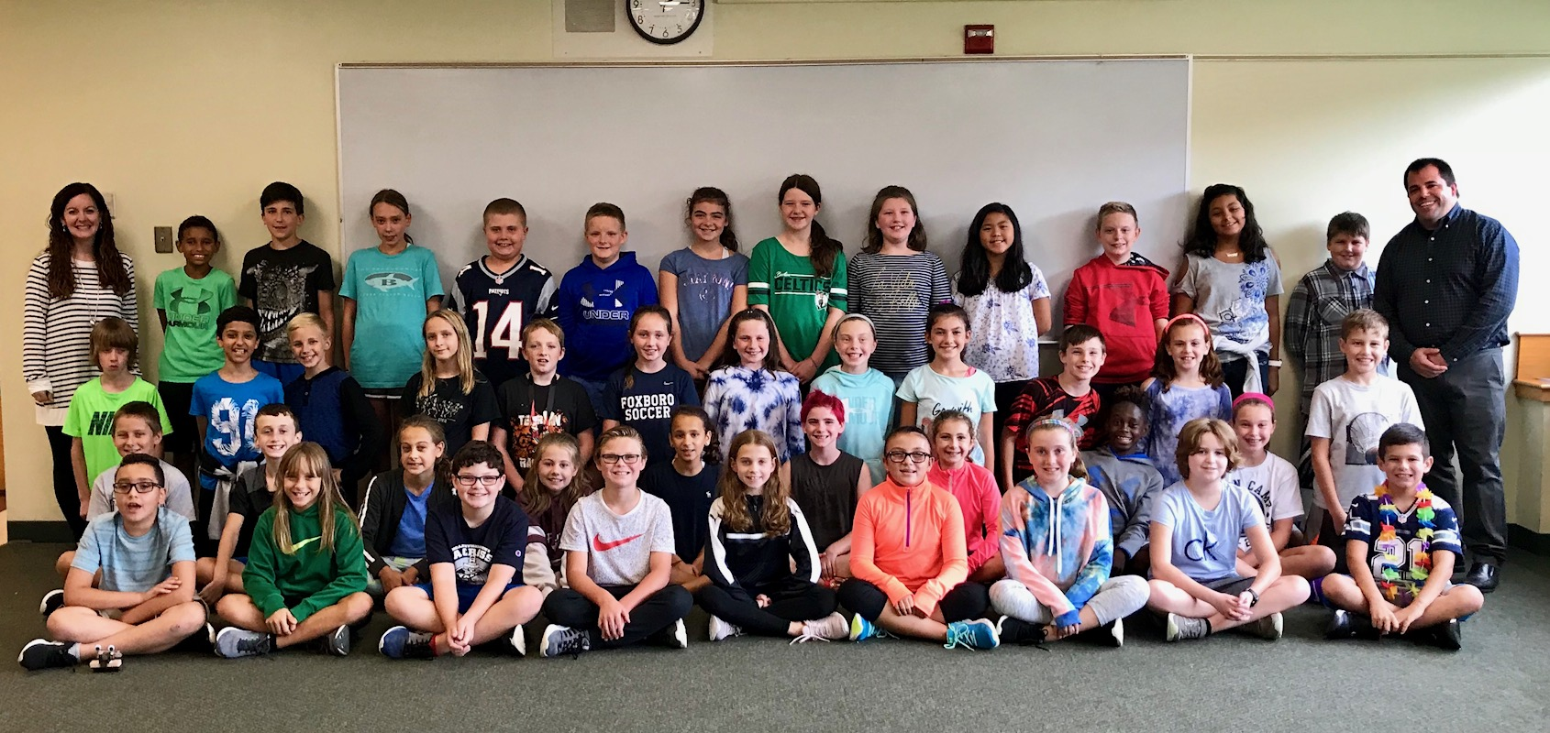
Welcome to House 5B!

Slide 2
Student Expectations
Come to school and class prepared to learn
Take responsibility for their actions
Treat others with the respect they deserve
Work cooperatively with students and adults
Take pride in their work

Slide 3






Math (9x per cycle)
W.I.P. and Bank Binders
Learning Goals Unit Cover Sheets
Homework
  Topics:
Place Value, Multi-Digit Multiplication, Division Modeling, Decimals, Fractions, Geometry, Problem Solving.

Slide 4

Science (6x per cycle)
STEMscopes
Learning through experiments and hands on labs
Life Science, Physical Science, Earth and Space Science
S.T.E.M. activities ~ one per term

Slide 5
ELA
ELA consists of reading and writing in the workshop model. Students will be reading and writing independently quite a bit and receiving regular feedback on their progress.
Please remind your child to read every single night for at least twenty minutes.
Writing occurs across three genres: Narrative, Informational, and Argument.
Spelling lists / tests are not given weekly. During our novel studies, however, students will be tested on vocabulary.

Slide 6

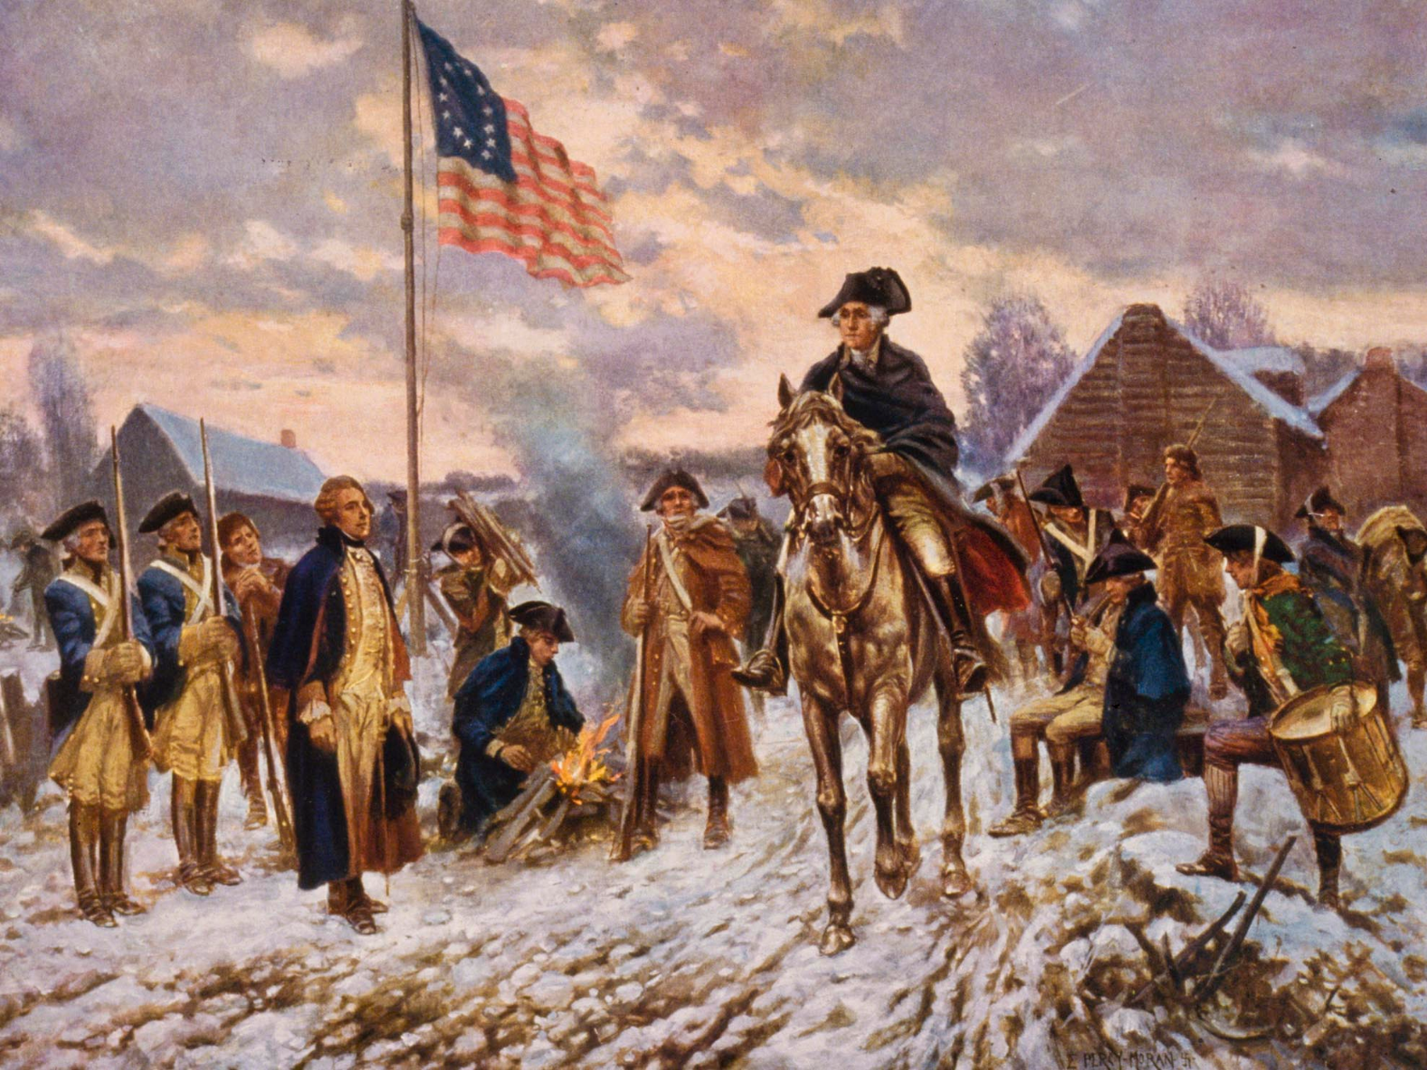

Social Studies (3x per cycle)
Topics include:
Geography
Early English Settlements
Colonial Life
American Revolution
Constitution
Civil War
Civil Rights Movement

Slide 7

Grades
Letter grades are new and can cause stress
Elementary school is VERY different-anticipating certain letter grades can lead to increased anxiety
Report cards are issued quarterly, but grades can be checked anytime through Power School.

Slide 8
Retake Procedure
“If at first you don’t succeed…”
Each child may be given an opportunity to “toss out their original test” and receive a new and improved score if they:
  Get the original test signed by a parent/guardian
  Make the corrections to the original assessment
  Stay after school for extra help and to retake the test

Slide 9
More on the Retake Procedure
Term 1 = Anyone below the "A" range can retake and only the 2nd test will count
Term 2 = Anyone below the "B" range can retake and only the 2nd test will count
Term 3 = Anyone below the "B" range can retake, but the two scores will be averaged
Term 4 = Anyone below the "C" range can retake, but the two scores will be averaged

Slide 10
After School
Students are welcome to stay after school on Thursdays with Mr. V. and Mrs. Blanchard
These sessions last an hour (2:25-3:25)
Students can take a late bus home, walk, or get picked up by an adult
This is not a punishment-it is an opportunity to get homework done, prepare for an upcoming quiz/test, or use the materials in the classroom
There will be no afterschool help session or activities on the third Thursday of each month due to a staff meeting.

Slide 11
Keep in touch!
Please feel free to email us at : vogelgesangc@foxborough.k12.ma.us
blanchards@foxborough.k12.ma.us
You can call us:
    508-543-1610
      Ext. 54106 for Mrs. Blanchard
      Ext. 54108 for Mr. V
Hand-written notes work fine, too

